Slide 1
k-Nearest Neighbors (k-NN)

Slide 2
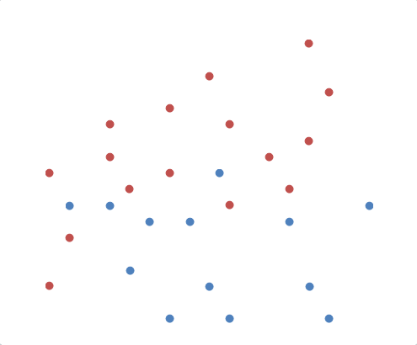
Classification
How to Predict Class of Unknown Data?

Slide 3
Classification
K-Nearest Neighbors
  Choose k nearest neighbors
  Determine the class based on the majority
k=1, Red
k=3, Blue
k=5, Blue

Slide 4
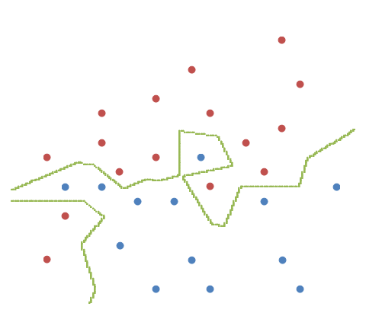
Classification
K-Nearest Neighbors
  K =1

Slide 5
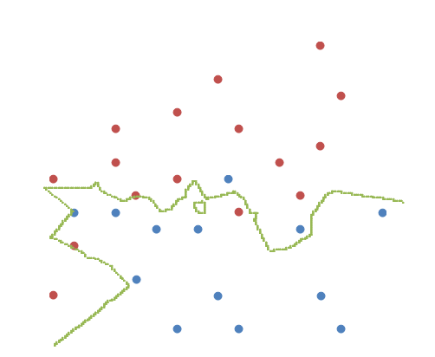
Classification
K-Nearest Neighbors
  K =3

Slide 6
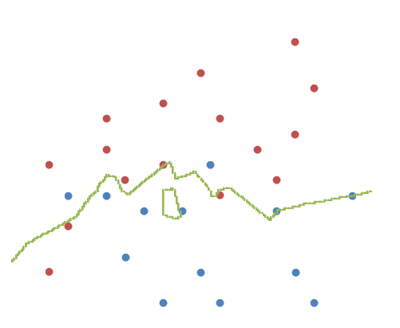
Classification
K-Nearest Neighbors
  K =5

Slide 7
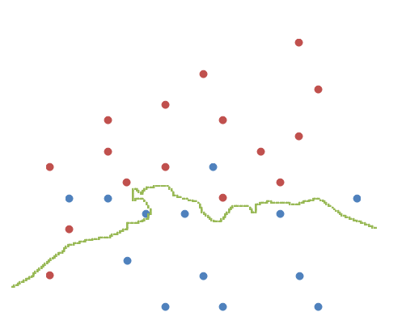
Classification
K-Nearest Neighbors
  K =10

Slide 8
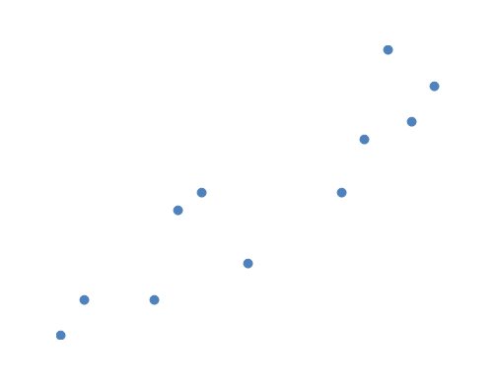
Regression
How to predict “y” value of unknown data
y
x

Slide 9
Regression
K-Nearest Neighbors
  Choose k nearest neighbors in X axis
  Predict the average of their “y”
x

Slide 10
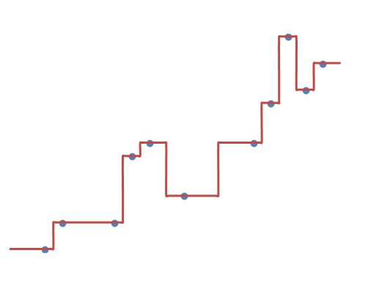
Regression
K-Nearest Neighbors
  K=1
x

Slide 11
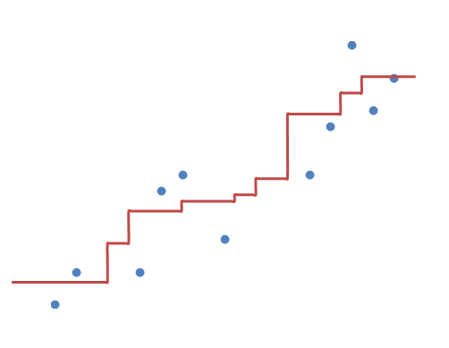
Regression
K-Nearest Neighbors
  K=3
x

Slide 12
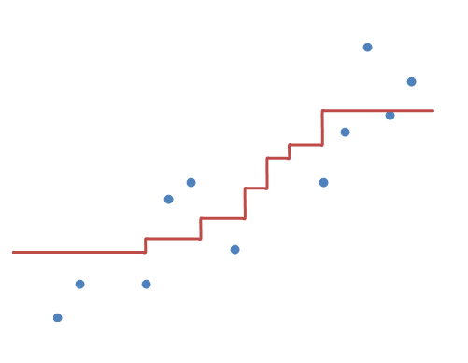
Regression
K-Nearest Neighbors
  K=5
x

Slide 13
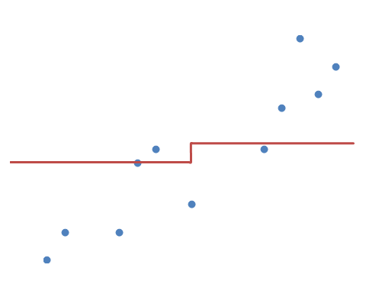
Regression
K-Nearest Neighbors
  K=10
x

Slide 14
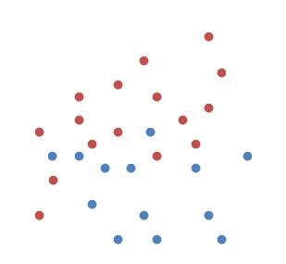
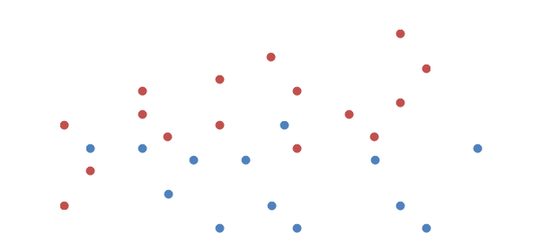

Distance Measure
Two data sets
  Compare the boundaries in D1 and D2 (1-NN)
D1
D2

Slide 15
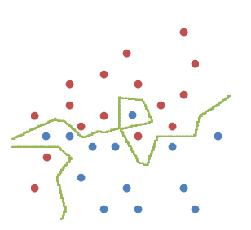
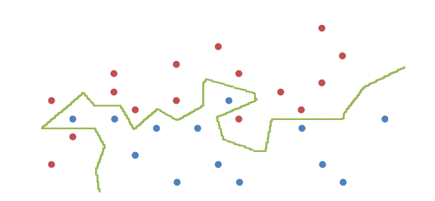
Distance Measure
Two data sets
  Even though the data are linearly scaled,
  the boundary changes!!
  You may need to choose other distance measures
D1
D2

Slide 16
Summary
Which k is better?
  Small k : higher variance (less stable)
  Large k : higher bias (less precise)
Proper choice of k
  Depending on the data
  Use Cross-validation

Slide 17
Summary
Advantage
  No training (Only inference step)
  Complexity of target functions do not matter
  No lose of information
Disadvantage
  Have to keep all data -> Memory space
  Affected by local structure of training data
  Sensitive to noise
  If training data is imbalanced, major class may dominate
  Need to calculate the distance from all training data -> Time
  Calculating distance in high dimensional space is expensive
  In high dimensional space, nearest neighbors are not near
    Curse of dimensionality

